Slide 1
Automated Guided Vehicle/ Autonomous Mobile Robot
By: Azizi Bin Mohamad Tambi (1919661)

Slide 2
Table of contents
01.
02.
03.
INTRODUCTION
HISTORY & APPLICATION
MAIN COMPONENTS
04.
05.
06.
BUILDING YOUR OWN
MALAYSIA MARKET
CONCLUSION

Slide 3
INTRODUCTION
01.

Slide 4
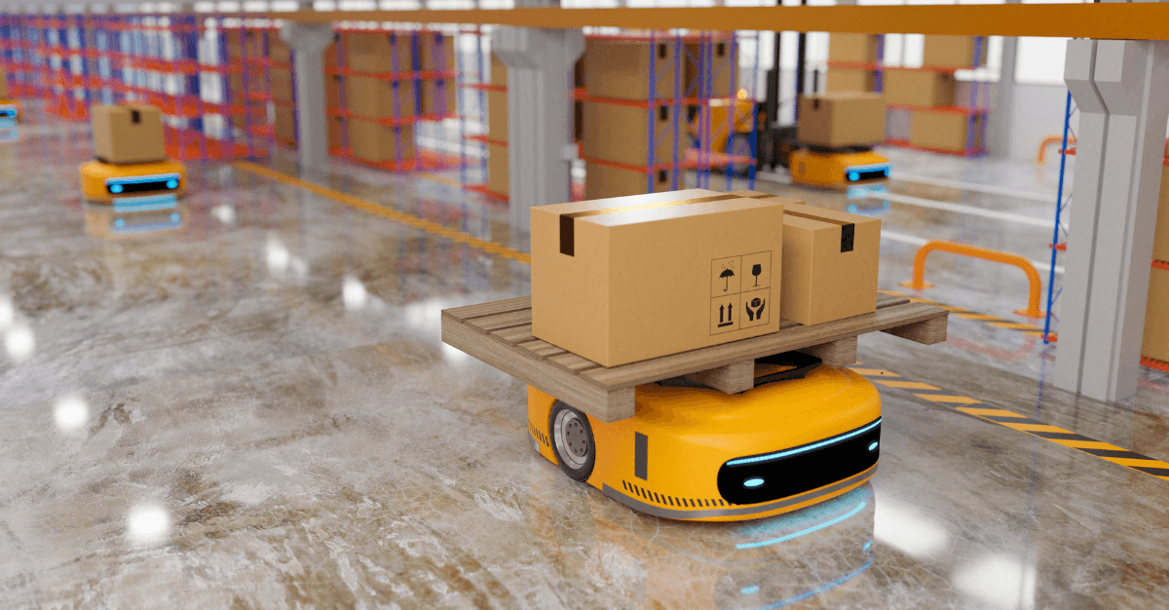
ABOUT AGV
AGV stands for Automated Guided Vehicle.
It is a computer-controlled, self-guided vehicles that used to transport materials, products or goods without human intervention.
These vehicles are equipped with sensors and navigational tools that allows them to move safely and efficiently.
Usually, we can found AGV in a warehouse, manufacturing facility or distribution center.

Slide 5
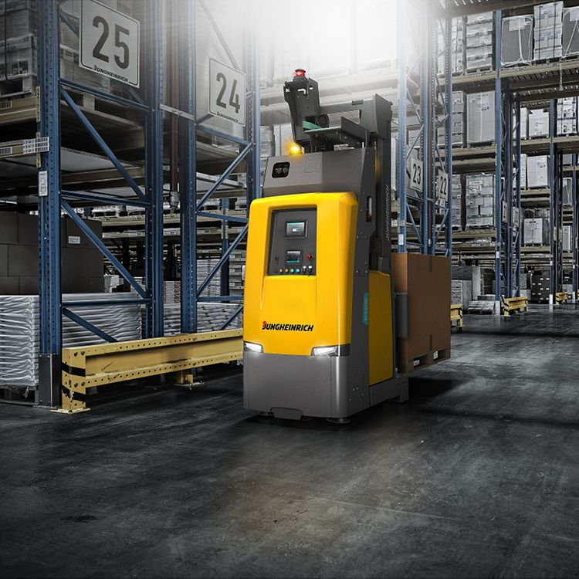
RESEARCH BACKGROUND ON AGV
The first AGVs were developed and deployed in the automotive industry to transport raw materials and finished goods between different production lines.
By 1980s, as technology has become more advanced, AGVs had become a common sight in manufacturing plants, warehouses and distribution centers.
Early AGVs were limited to following a fixed path or using wires embedded in the floor to guide their movement.
Recent research has allow AGVs to detect obstacles and adjust their path in real-time.

Slide 6
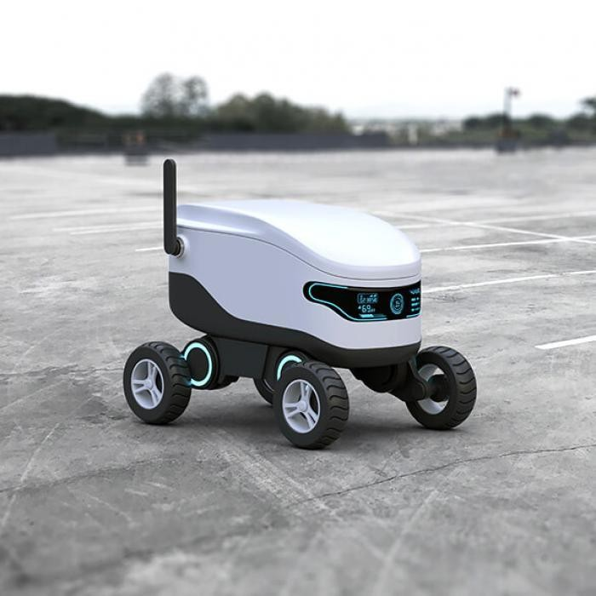
ABOUT AMR
AMR stands for Autonomous Mobile Robot.
AMR is same as AGV where it is capable of operating independently and moving around in a variety of environments without the need for human intervention.
AMRs are equipped with sensors, cameras, and other navigational tools that allow them to map their surroundings, detect obstacles and hazards to plan the most efficient route to their destination.
AMRs can be programmed to perform a wide range of tasks such as material handling, transportation, inspection and assembly.

Slide 7
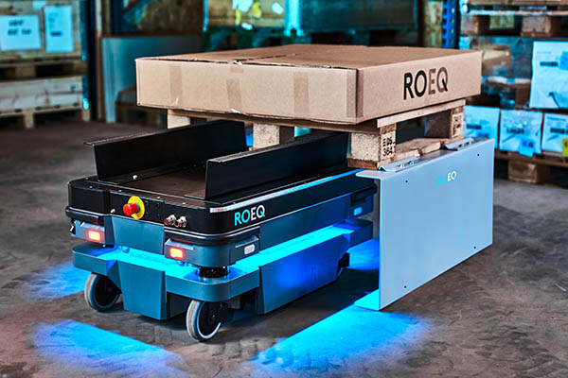
RESEARCH BACKGROUND ON AMR
Early research on AMRs focused on developing the fundamental concepts of mobile robotics, including navigation, obstacle avoidance, and mapping.
Back then, AMRs were often controlled by human operators or followed pre-programmed paths.
As technology has become more advanced, AMRs were developed to transport materials and product between production lines in manufacturing facilities.
Recent research has focused on developing more intelligent and autonomous AMRs that can adapt to dynamic environment and perform a wider range of tasks.

Slide 8
HISTORY & APPLICATIONS
02.

Slide 9
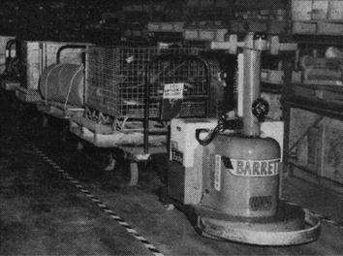
THE FIRST AGV
The first AGV was developed in the early 1950s by Barrett Electronics Corporation, a company based in Northbrook, Illinois.
This AGV was initially designed to transport materials in a grocery store warehouse.
The 1st AGV was a tow tractor that could move along a wire embedded in the warehouse floor where the wire was used to guide the AGV along a pre-determined path.
This AGV was powered by a 24-volt battery and was capable of towing a load up to 15K pounds.

Slide 10
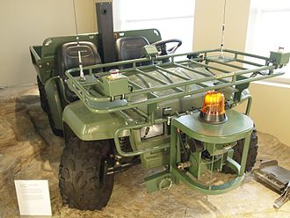
THE FIRST AMR
The first AMR was developed in late 1990s by a team of researchers at Carnegie Mellon University’s Robotics Institute in Pittsburgh, Pennsylvania.
It was called the “Gator” (General Autonomous Tasking of Robots), designed to perform a wide range of tasks in industrial and military environments.
Equipped with a range of sensors, including cameras and laser range finders, that allowed it to navigate autonomously and avoid obstacles.
The Gator was designed to be highly modular, allowing users to add or remove components depending on the specific task at hand.

Slide 11
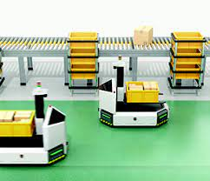
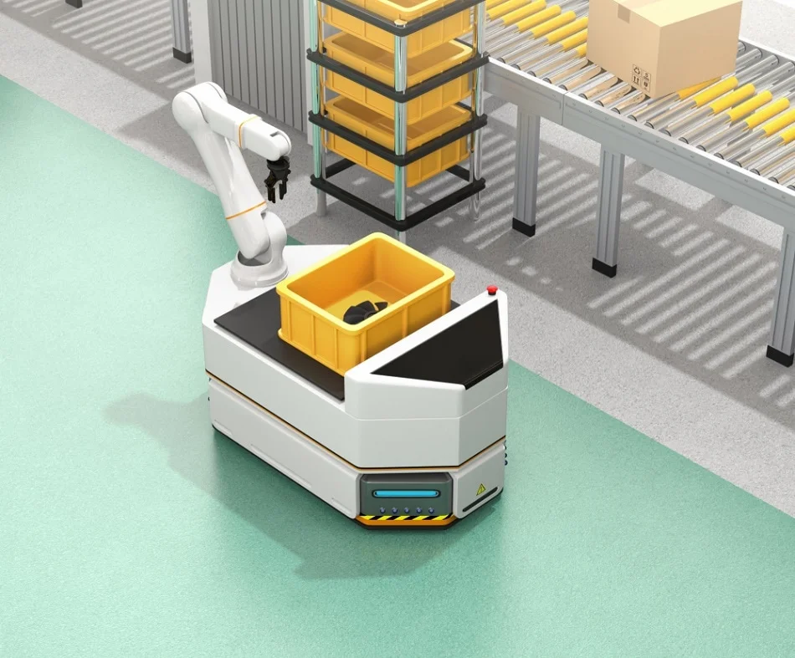
APPLICATION
AGVs:
AMRs:
Material handling
Transportation
Assembly line feeding and uploading
Order picking and replenishment
Moving parts and components in production lines.
Moving equipment, supplies and medical waste.
Material handling and transportation
Logistics and e-commerce operations
Inspection and maintenance tasks
Medication and supply delivery
Patient transportation and disinfection

Slide 12
MAIN COMPONENTS
03.

Slide 13
03. MAIN COMPONENTS
I. Frame & Design
II. Propulsion System
III. Navigation & Control System
IV. Data Collection
V. Data Transmission
VI. Power Management

Slide 14
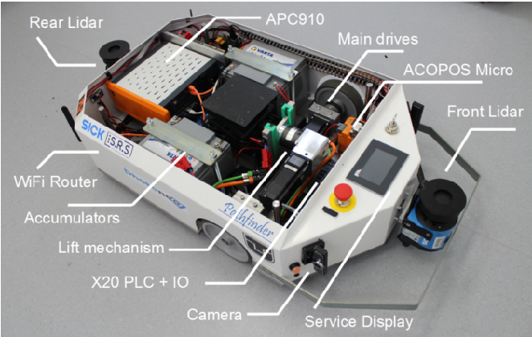
Frame & Design for AGVs
Typically have a flat, rectangular frame that is low to the ground, with wheels or casters attached to the underside.
The frame is designed to accommodate the load being transported which may be a pallet, a container or other.
The material used for the frame are depending of the application and requirements of the vehicles. Aluminium, Steel, Carbon Fiber and Plastic are a common material used for the frame.

Slide 15
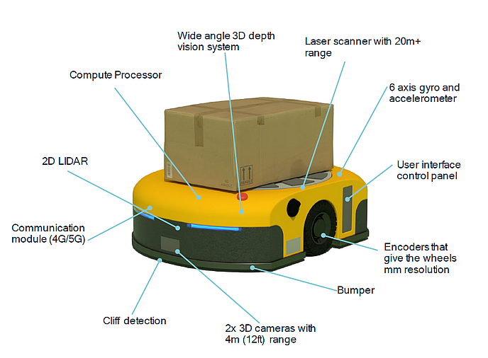
Frame & Design for AMRs
AMRs have a more compact and versatile design that allows them to move around in confined space and navigate more complex environments.
AMRs have variety of shapes and sizes depending on the application and environment.
Some of shapes are cylindrical, box-like shape with wheels, tracks, or legs that allow them to move around obstacles.
The material used for the frame of AMRs depend with the function of the vehicle but it is not limited to only Aluminium, Steel, Carbon fiber and plastic.

Slide 16
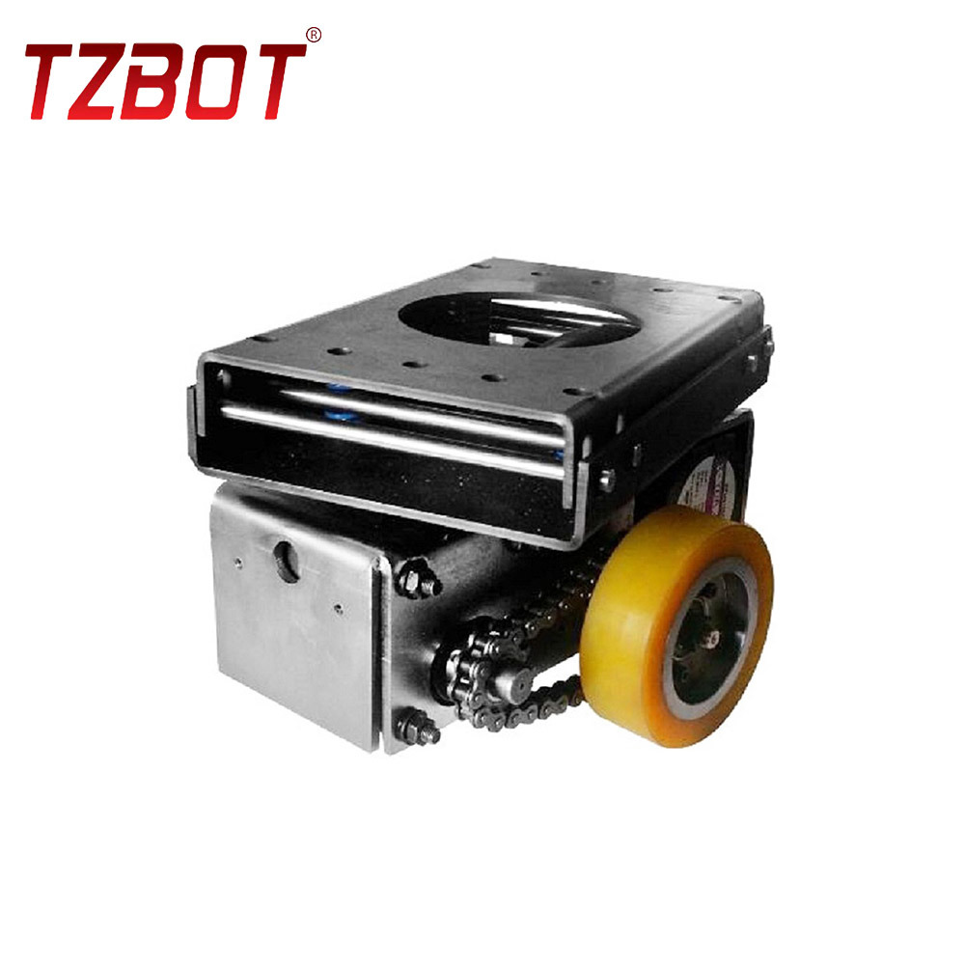
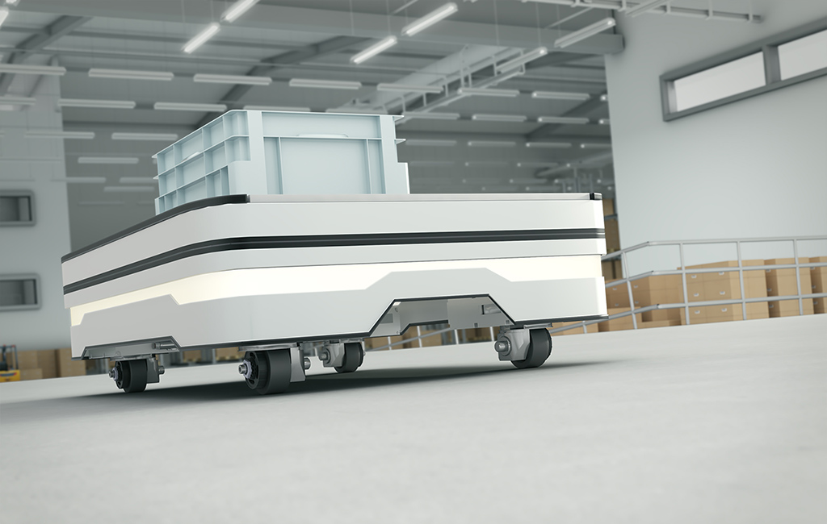
II. Propulsion System for AGV
Differential Drive
Omni-Differential Drive
AGVs use 2 drive wheels, which are controlled independently using motors.
By varying the speed and direction of each wheel, it can move in any direction.
Use multi-directional wheels that enable the AGV to move in any direction, without needing to turn around.
Allows the AGV to rotate around its axis while moving forward, backward or sideways.

Slide 17
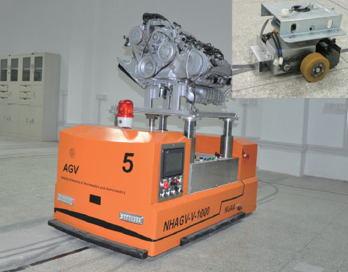
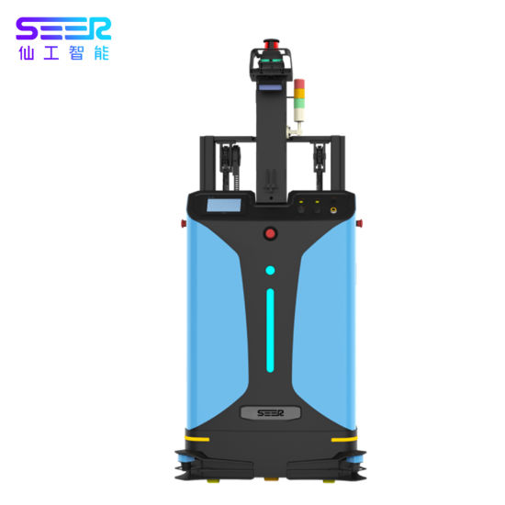
II. Propulsion System for AGV
Magnetic Drive
Laser Guided Drive
AGVs can use magnetic propulsion systems that use magnetic tape of markers placed on the floor to guide their movements.
Magnetic sensors located on the AGVs can detect position and orientation of magnetic field.
Use lasers to detect the position and orientation of reflective markers placed on the floor.
Can follow a pre-programmed path based on the position and orientation of the markers.

Slide 18
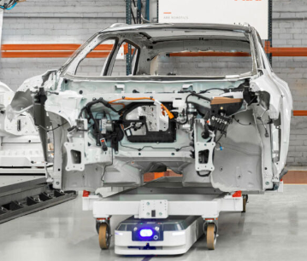
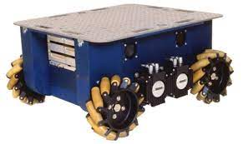
II. Propulsion System for AMR
Wheel-Based Propulsion
Track-Based Propulsion
The robots moves on wheels driven by electric motors.
The wheels may be omnidirectional, allowing the robot to move in any direction, or may be unidirectional, where the robot turns by moving its wheels in opposite direction.
The robot moves on tracks that are driven by electric motors.
Well-suited for rough terrain and outdoor environments, where the robot needs to navigate over uneven surfaces.

Slide 19
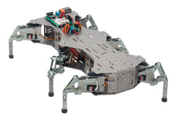
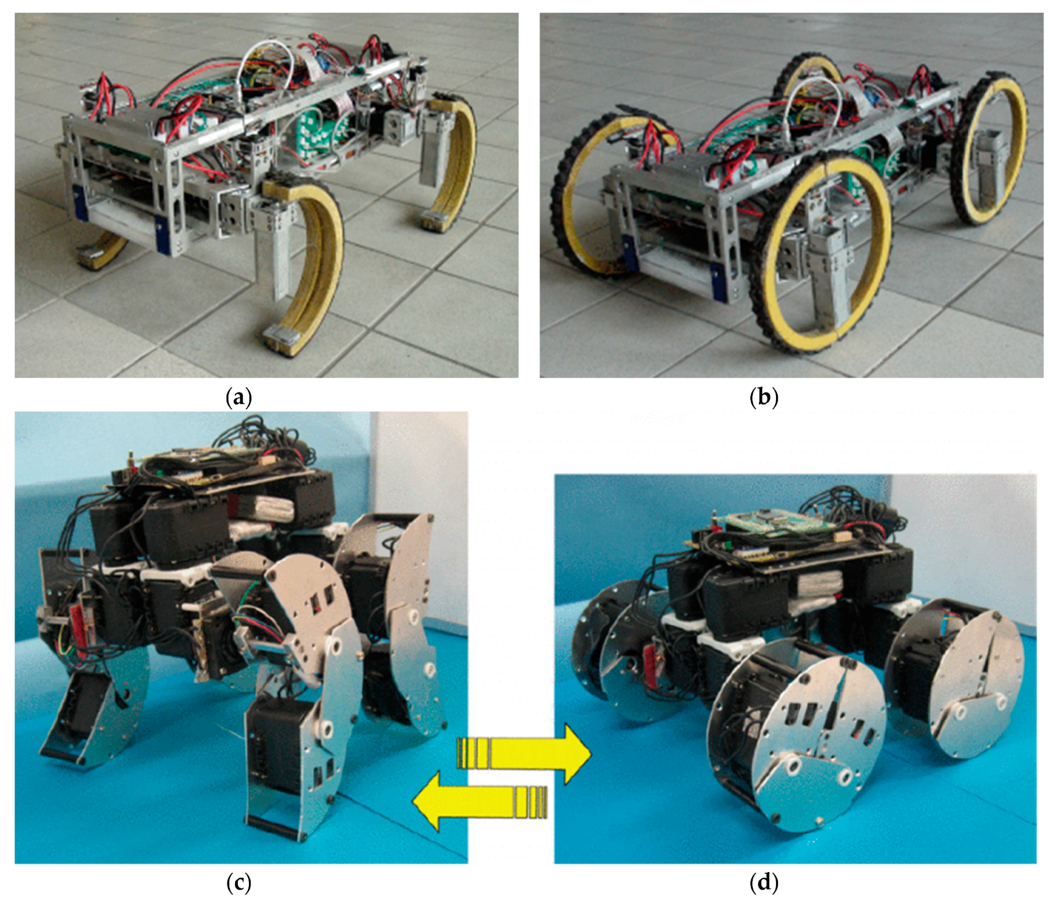
II. Propulsion System for AMR
Legged Propulsion
Hybrid Propulsion
The robots moves on wheels driven by electric motors.
The wheels may be omnidirectional, allowing the robot to move in any direction, or may be unidirectional, where the robot turns by moving its wheels in opposite direction.
The robot moves on tracks that are driven by electric motors.
Well-suited for rough terrain and outdoor environments, where the robot needs to navigate over uneven surfaces.

Slide 20
III. Navigation & Control System for AGV
Magnetic Tape Navigation:
Inertial Navigation:
Optical Navigation:
Laser Guidance:
Vision-Based:
A magnetic tape is placed on the floor of the facility to guide AGV. AGV is equipped with magnetic sensors that detect the magnetic field generated by the tape.
AGV equipped with sensors that measure its acceleration, speed, and rotation.
Uses optical sensors to detect and follow pre-determined path marked on the floor.
Uses lasers to guide the AGV’s movement.
Laser scanner mounted on the AGV emits a laser beam that bounces off reflectors placed on the facility walls, creating a map of the environment.
Uses cameras and computer vision to navigate AGV.
The camera captures images of the environment, which are processed to create a map of surroundings.

Slide 21
III. Navigation & Control System for AGV
Central Control Unit:
Safety System:
Sensors:
Communication System:
The brain of AGV’s control system.
Receives inputs from sensors and navigation system, processes data and send commands to propulsion system and actuators.
Used to prevent accidents and ensure safety.
Includes emergency stop buttons, obstacle sensors and collision avoidance.
Used to detect the AGV’s position, orientation, surroundings.
Magnetic, optical, laser or vision-based sensors.
Enables the AGV to exchange data with other machines.
Use wired or wireless connections such as Ethernet, CAN bus, or Wi-Fi.

Slide 22
III. Navigation & Control System for AMR
SLAM:
Inertial Navigation:
Ultrasonic Navigation:
Magnetic Guidance:
Vision-Based:
Uses sensors such as lidar, cameras or sonar to create a map of the environment and simultaneously determine the robot’s position within that map.
Map is updated as the robot moves.
AMR equipped with sensors that measure its acceleration, speed, and rotation.
Use Ultrasonic sensors to detect obstacles and map the environment.
A magnetic tape is placed on the floor of the facility to guide AMR. AMR is equipped with magnetic sensors that detect the magnetic field generated by the tape.
Uses cameras and computer vision to navigate AMR.
The camera captures images of the environment, which are processed to create a map of surroundings.

Slide 23
III. Navigation & Control System for AMR
Central Processing Unit:
Safety System:
Sensors:
Communication System:
Actuators:
Main control unit of AMR.
Receives inputs from sensors and navigation system, processes theh data, and send commands to the propulsion systems and actuators.
Used to prevent accidents and ensure safety.
Includes emergency stop buttons, obstacle sensors and collision avoidance.
Used to detect the AMR’s position, orientation, surroundings.
Lidar, cameras, sonar, or ultrasonic sensors.
Use wired or wireless connections such as Ethernet, CAN bus, or Wi-Fi.
Grippers or arms can be used to pick up and manipulate objects.

Slide 24
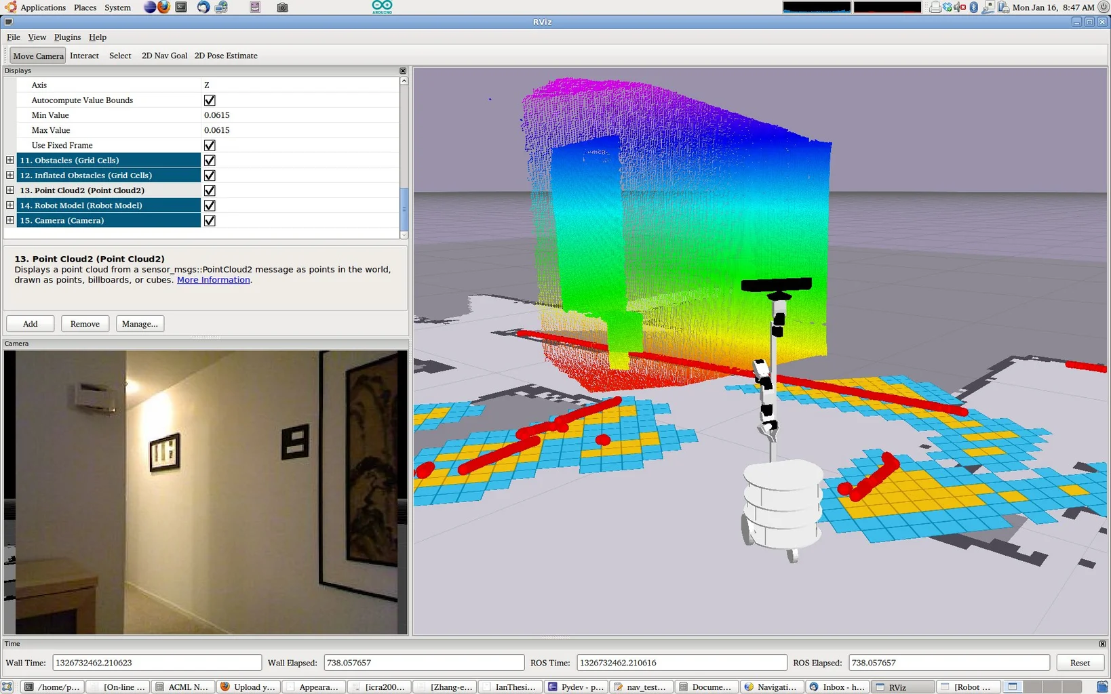
NAVIGATION SOFTWARE (ROS)

Slide 25
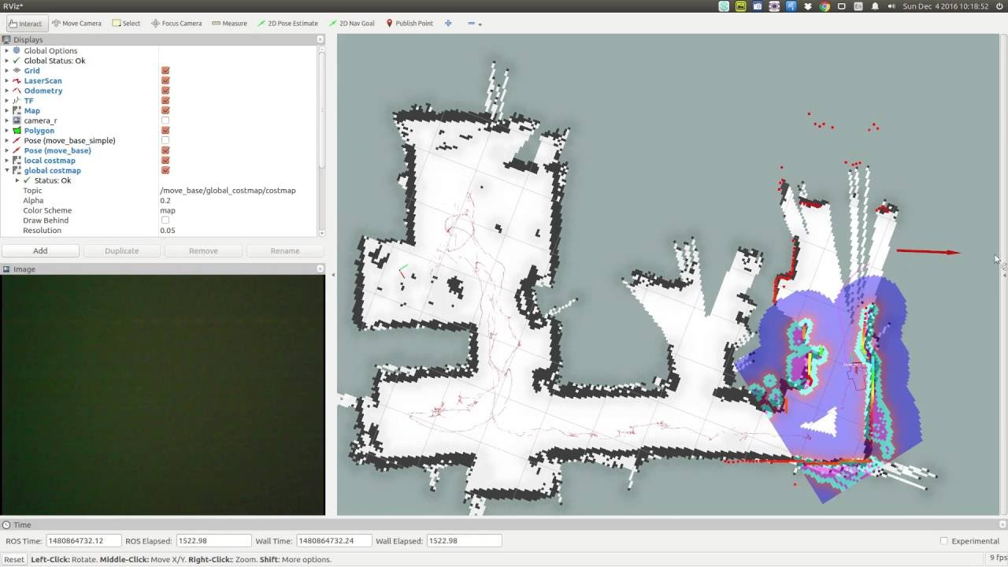
NAVIGATION SOFTWARE (SLAM)

Slide 26
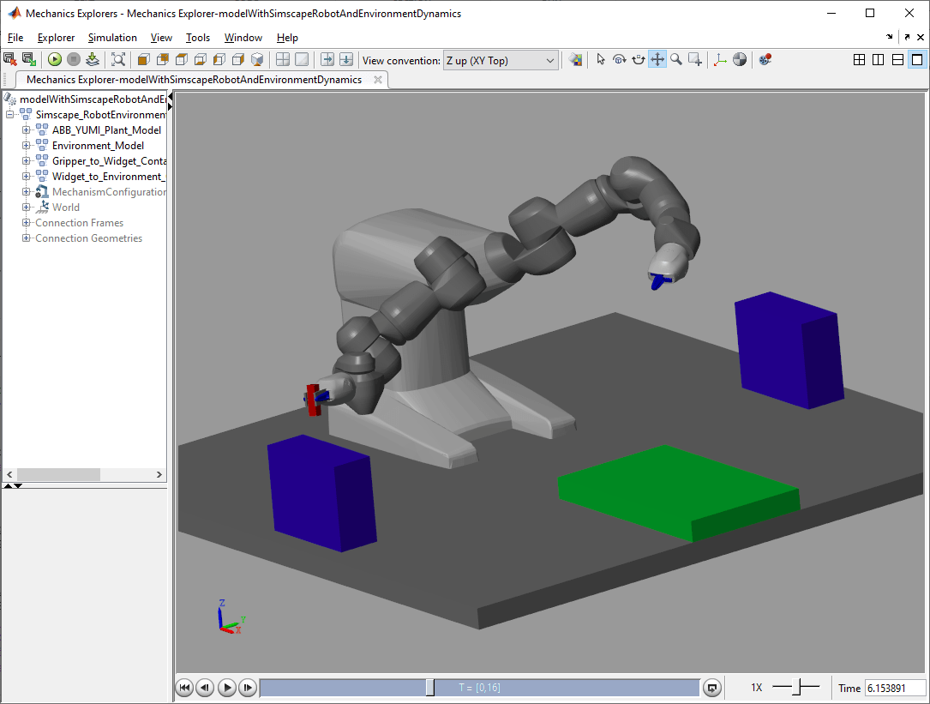
NAVIGATION SOFTWARE (MATLAB)

Slide 27
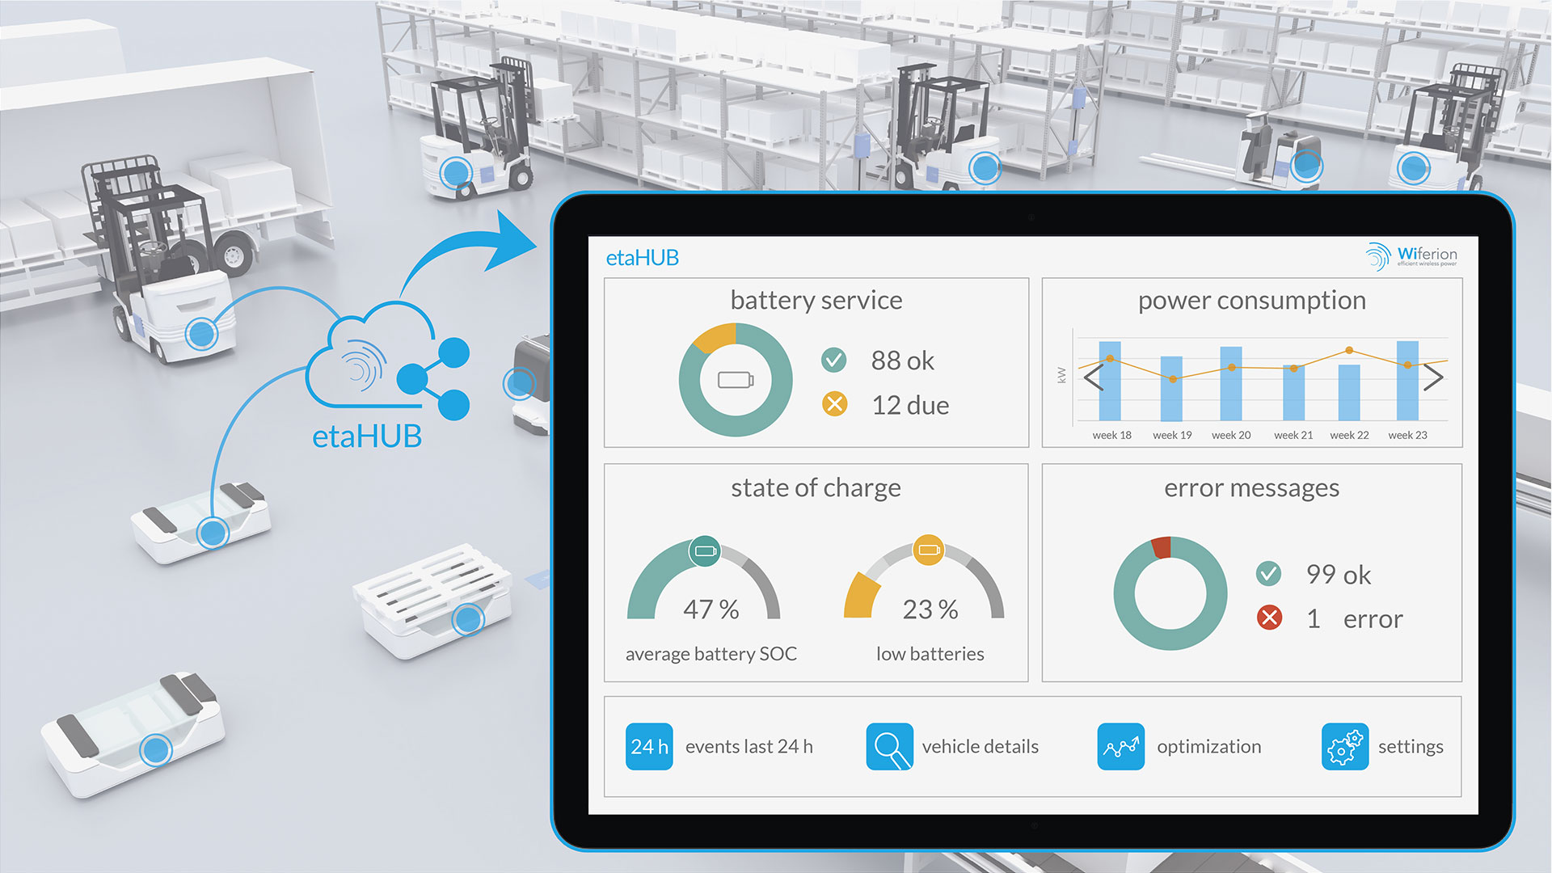
NAVIGATION SOFTWARE (AGV Fleet Management Systems)

Slide 28
IV. Data Collection
Sensors:
Actuators:
Lidar
Camera
Sonar/ Ultrasonic Sensor
Infrared Sensor
Encoders
GPS
Electric Motors
Pneumatic Cylinders
Gripper or arms
Conveyor Belts
Vacuum Suction Cups

Slide 29
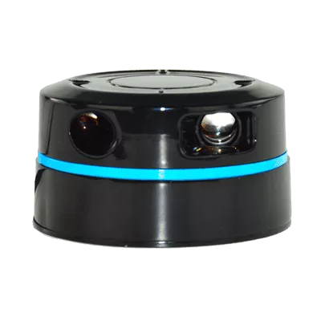
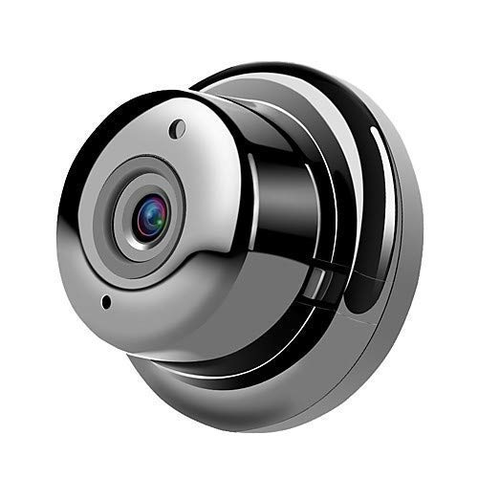
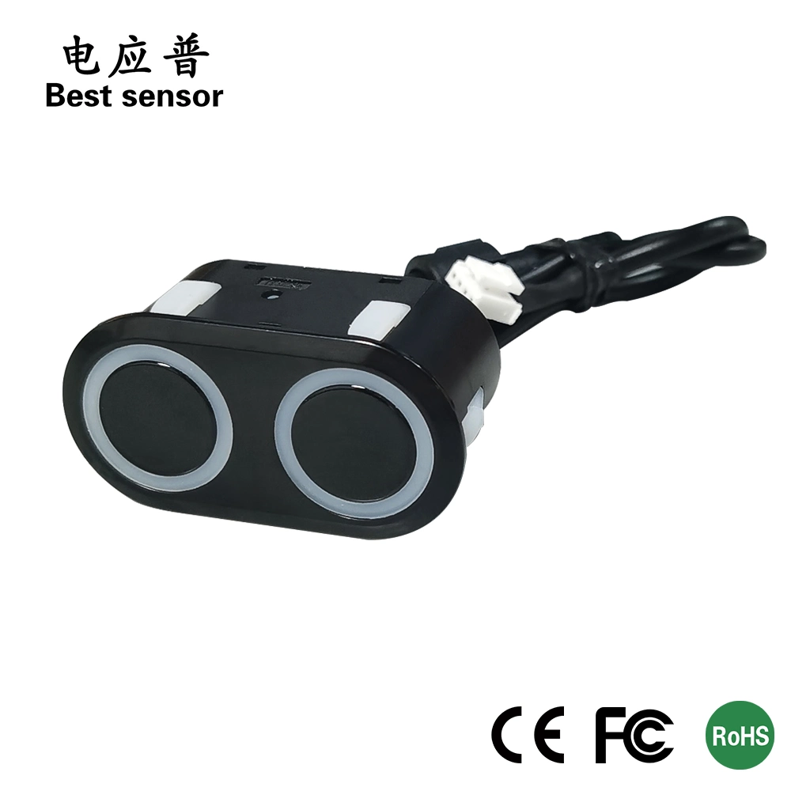
LIDAR:
CAMERAS:
SONAR:

Slide 30
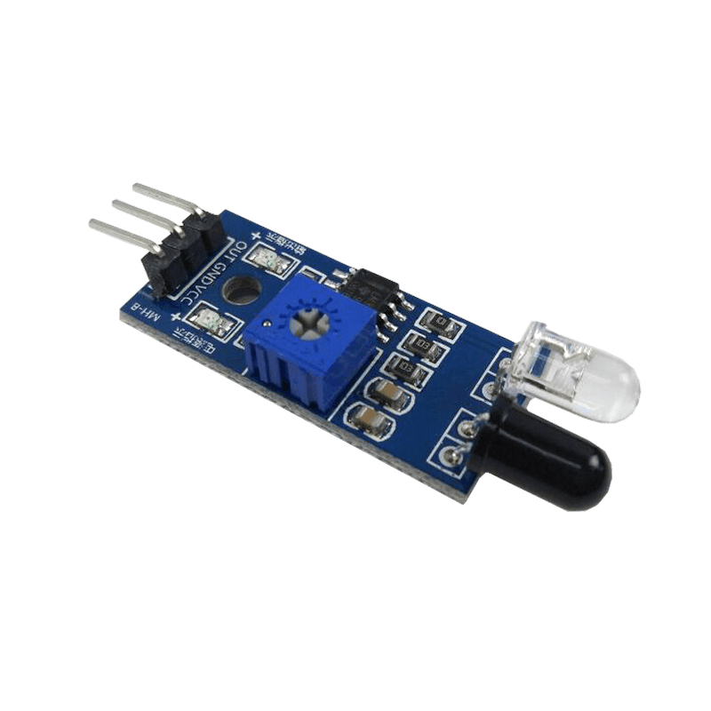
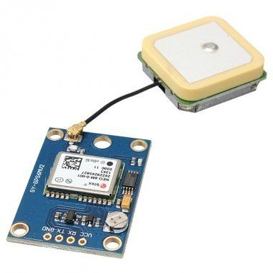
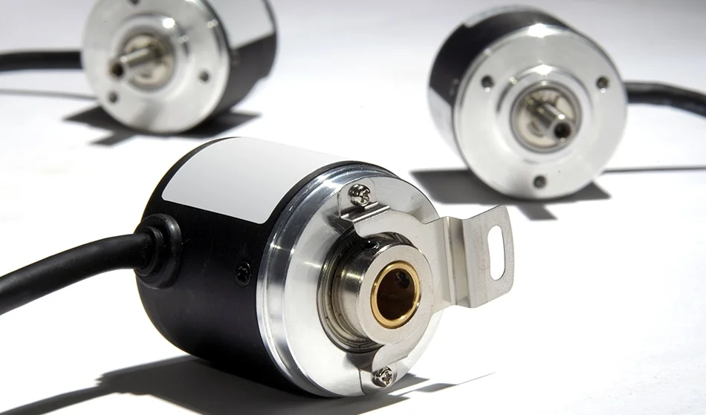
INFRARED:
ENCODERS:
GPS:

Slide 31
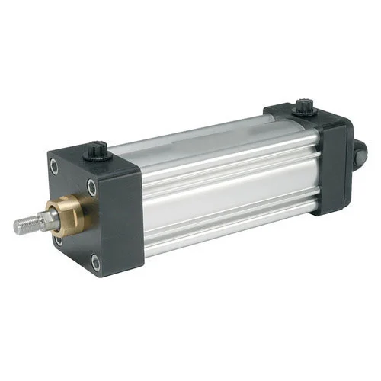
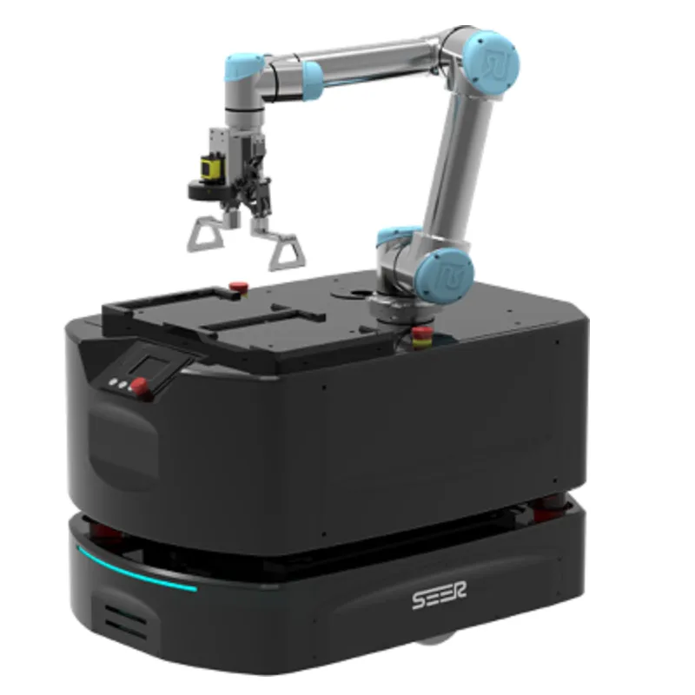
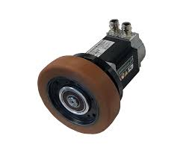
Electric Motors:
Pneumatic Cylinders:
Gripper:

Slide 32
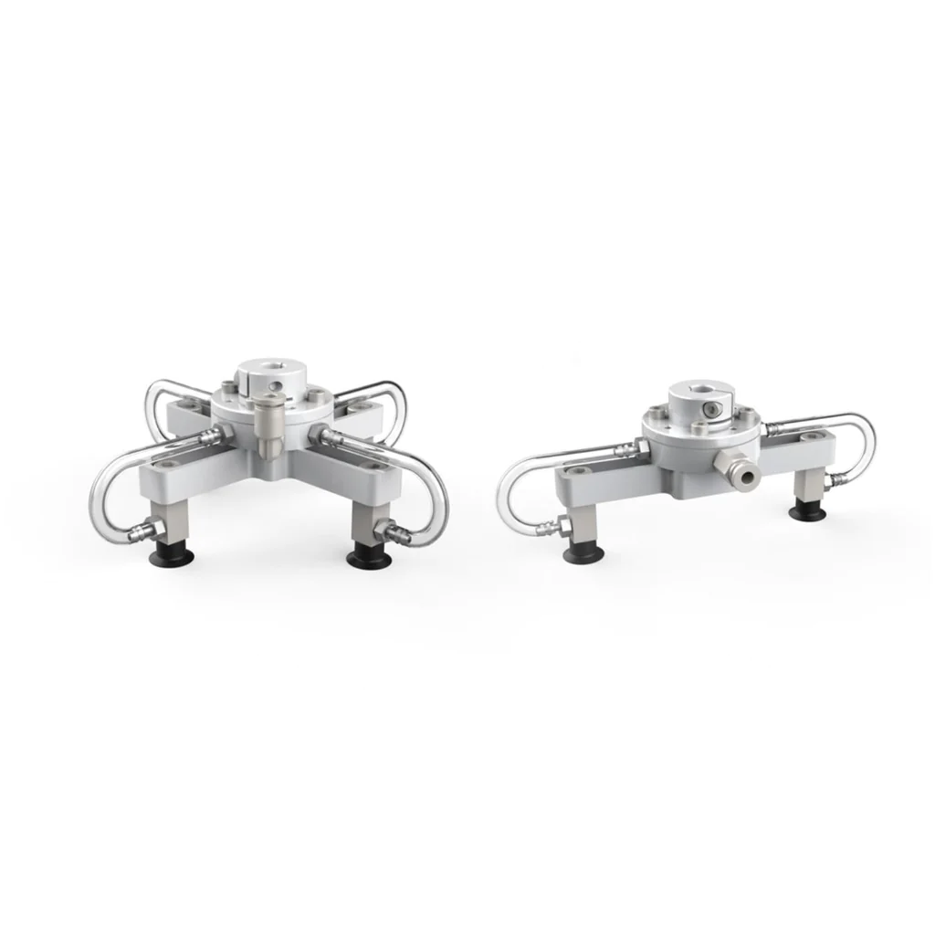
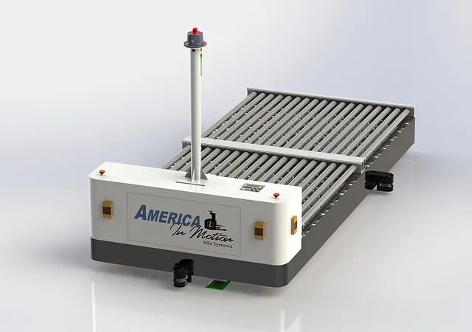
Conveyor Belts:
Vacuum Suction Cups:

Slide 33
V. Data Transmission
Wireless Communication:
CAN Bus Communication:
Ethernet Communication:
Wired Communication:
Both AMR and AGV often use wireless communication protocols such as Wi-Fi, Bluetooth, or ZigBee to transmit data between the robot and its control system or other devices.
A communication protocol commonly used in automotive and industrial application.
Used to connect sensors, actuators, and other devices in an AGV or AMR.
Often used to connect AGVs and other automation equipment to the factory network.
Provides a high-speed and reliable connection, allowing for real-time data transfer and control.
AGVs may be tethered to their control system or other devices using cables.

Slide 34
VI. Power Management
Battery System:
Energy Recovery System:
Power Distribution System:
Charging System:
Rechargeable battery systems is used to power the robot.
These batteries ranges from small low-voltage batteries to large, high-high voltage battery packs.
Help extend the runtime of AGVs and AMRs by capturing and reusing energy.
For example, regenerative braking can capture energy during deceleration and use it to recharge battery.
Distribute power from the battery system to the various motors, sensors, and other components in AGV or AMR.
These include voltage regulators, fuses, and circuit breakers to ensure safe and efficient operation.
The battery must be charged regularly to keep AGV or AMR running.
Include simple charging contacts or more complex charging stations that use sensor and communication protocols to optimize charging.

Slide 35
BUILDING YOUR OWN
04.

Slide 36
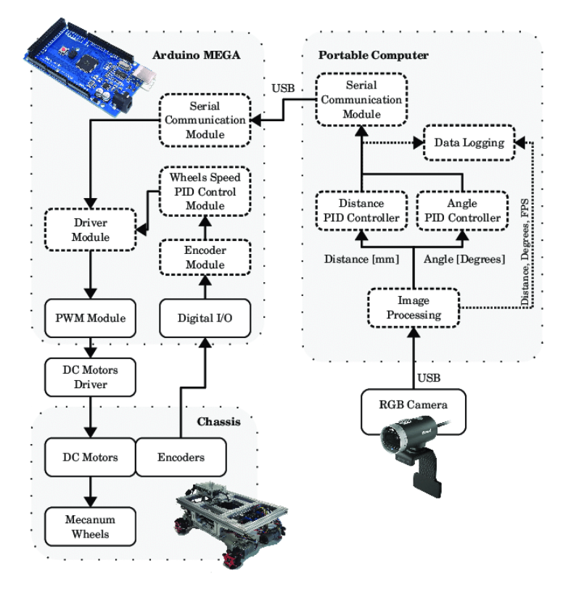
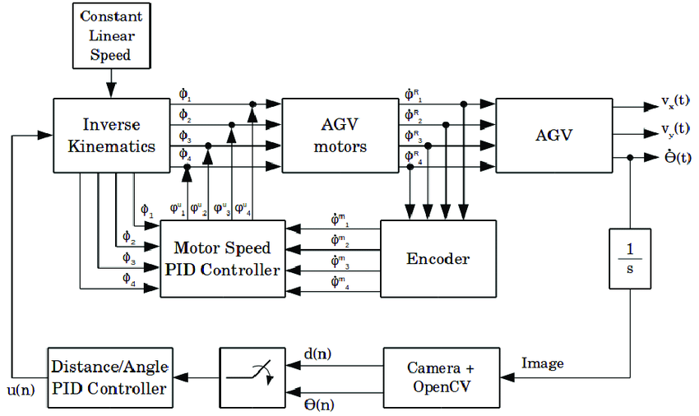
Complete AGV System Architecture

Slide 37
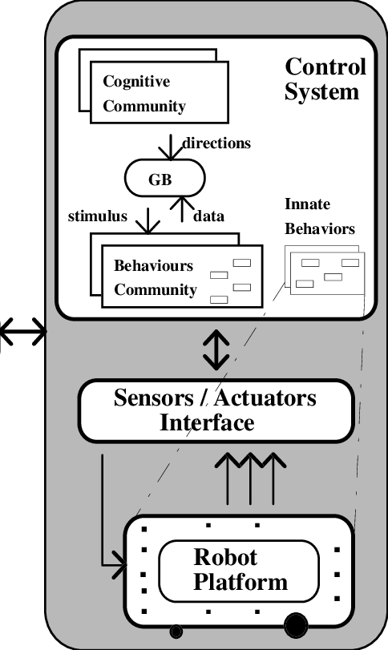
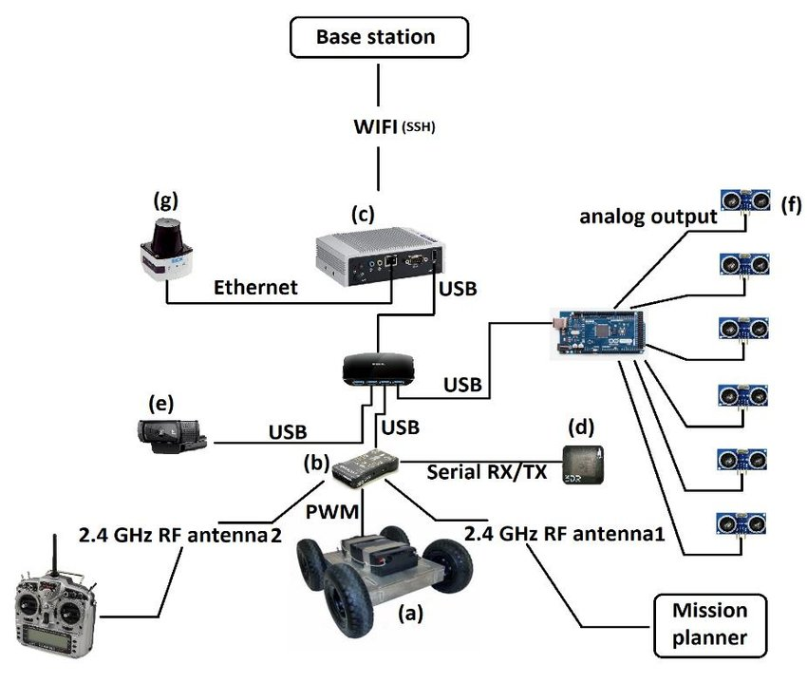
Complete AMR System Architecture

Slide 38
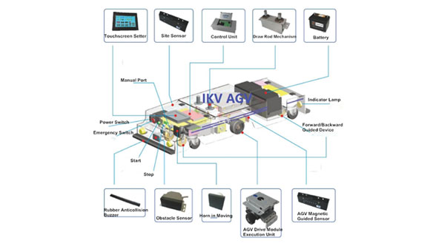
AGV Hands On Session

Slide 39
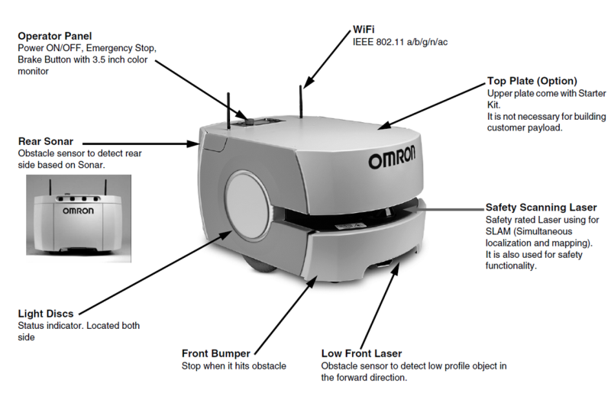
AMR Hands On Session

Slide 40
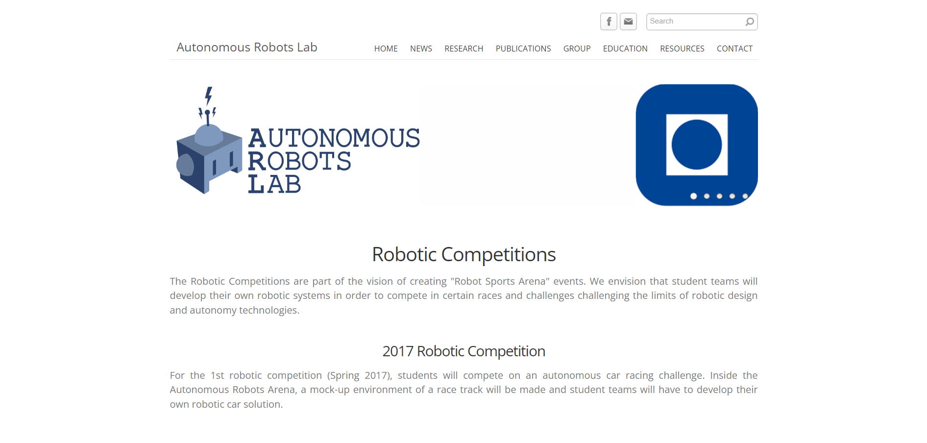

Slide 41
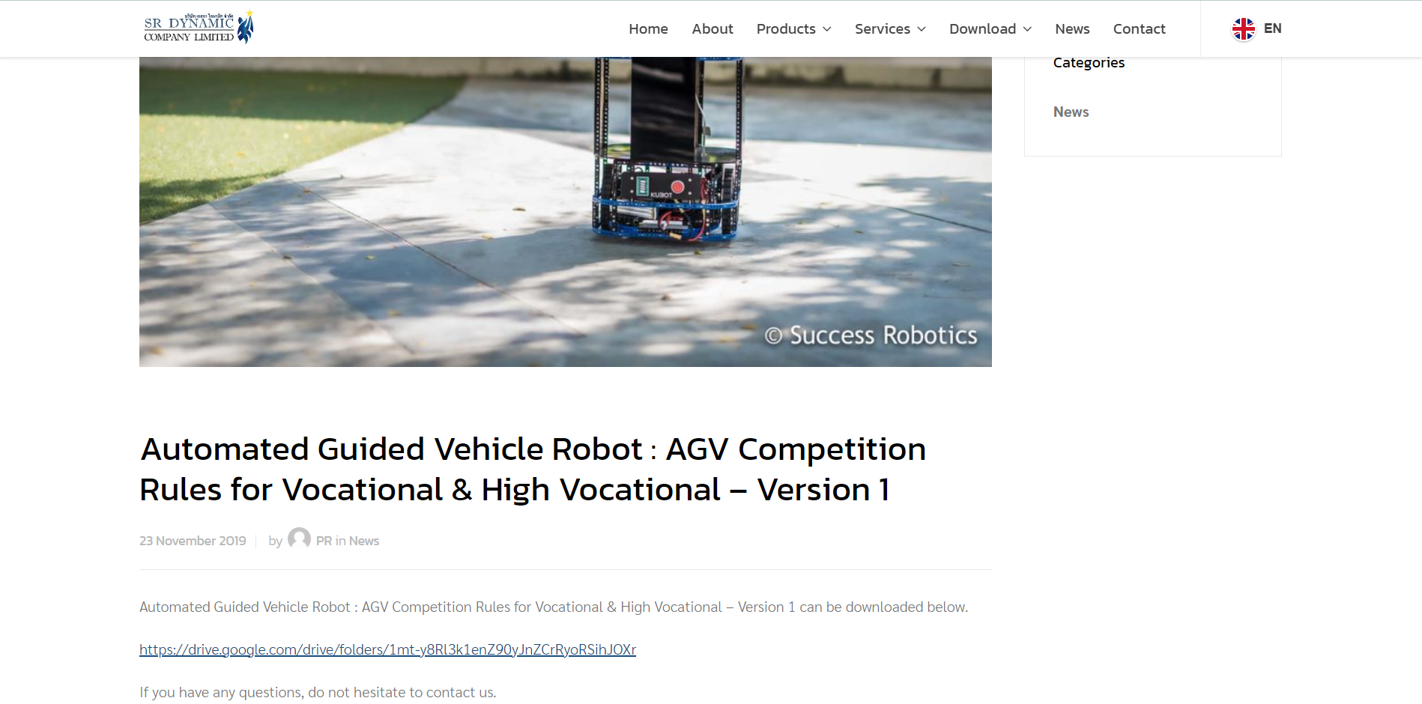

Slide 42
MALAYSIA MARKET
05.

Slide 43
MARKET PLAYER FOR AGV AND AMR
Daifuku Malaysia
FMC Technologies Malaysia
LKL Advance Metaltech
FlexMove System (M) Sdn Bhd
ST Engineering
Omron Malaysia
ABB Malaysia
8. MiR Asia 9. Kollmorgen Malaysia 10. Zebra Technologies Malaysia 11. Prostrain

Slide 44
WHO CAN USE AGV AND AMR IN MALAYSIA ?
Researchers
Manufacturing companies
Warehousing and distribution companies
Automotive industry
Healthcare industry
Food and beverage industry
Retail industry
8. Intel Malaysia 9. Panasonic Malaysia 10. Lazada Malaysia 11. Petronas 12. Top Glove 13. Proton 14. Ceva Logistics 15. Shopee Malaysia

Slide 45
Obstacles
Cost:
Safety Concerns:
Technical Expertise:
Infrastructure Limitations:
Initial investment in AGVs and AMRs can be expensive, especially for smaller companies.
AGVs and AMRs operate autonomously, which means they must be programmed and designed to avoid collisions with humans and objects.
Implementing AGVs and AMRs requires technical expertise in robotics, automation, and software programming.
Finding candidates with right talent and skills might be challenging.
AGVs and AMRs require a stable reliable wireless network for communication and data transfer.
In some areas, internet infrastructure may not be robust enough to support these systems.

Slide 46
Top things to remember operating AGV & AMR
Safety First:
Data Management:
Maintenance:
Battery Management:
Training:
AGVs and AMRs should be designed and programmed with safety in mind.
AGVs and AMRs generate significant amount of data, including performance metrics and sensor reading. It is important to have a plan for collecting, storing and analyzing data.
Regular maintenance is essential to keep AGVs and AMRs operating smoothly.
AGVs and AMRs are powered by batteries.
Therefore, it is essential to manage the battery life to ensure the systems operate as expected.
This includes monitoring the battery levels, charing the batteries regularly, and replacing them when necessary.
Employees who work with AGVs and AMRs should receive proper training on how to operate and interact with the systems safely.

Slide 47
CONCLUSION
06.

Slide 48
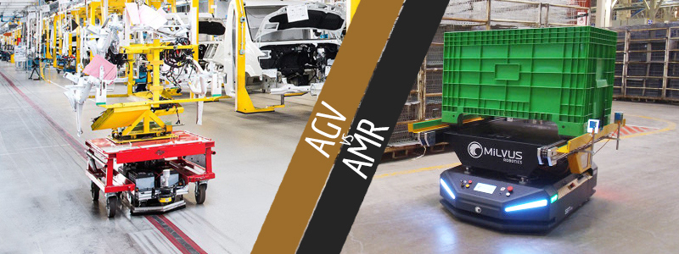
Conclusion
In conclusion, AGVs and AMRs are robotic systems used in industries to improve efficiency and safety. AGVs follow a predetermined path using sensors, while AMRs are autonomous robots that navigate using various technologies. They reduce manual labor, improve safety, and increase efficiency in various applications. Their implementation requires a significant investment, but it can be worthwhile. AGVs and AMRs are becoming more popular in Malaysia and other countries as companies seek to optimize operations and stay competitive.

